Slide 1
Week 4 Mapping User Stories
DESN2000 SENG Workshop
SENG, T2 2026

Slide 2
Overview – Mapping User Stories
2 hour workshop
Intro
Mapping user stories from last week
Group Work – read project brief/start thinking who is this for/
Intro | Mapping User Stories | Group Work | Wrap-up
5 min | 50 min | 50 min | 5 min
all | all | group | all

Slide 3
Overview – Why are we here today?
What you’ll aim for
At the end of the workshop you should understand:
How to strategically map user stories and create a sprint

Slide 4
Mapping User Stories
50 minutes
User story mapping can provide great insight in creating your product.
The technique was introduced by Jeff Patton and allows you to visualize your user stories in the greater context of the user’s journey and thus helps you to see the bigger picture of your product structure and of how to prioritise certain deliverables.
Intro | Mapping User Stories | Group Work | Wrap-up
5 min | 50 min | 50 min | 5 min
all | all | group | all

Slide 5
Mapping User Stories
50 minutes
This will be completed first as a class wide activity.
You will each be given a post-it note and now please write down a task that you would do with a content streaming platform
We will work at the front of the room now and post all our post-it notes on the board to start categorising and slicing
Cluster tasks into activities/remove duplicates – this will form a backbone (the entire user journey described in high-level tasks/steps from start to finish)
Notes:
This is usually done with post it notes and whiteboard arrangement, but they may use Miro, Confluence or Figma instead when they do their own in groupwork time
Ask each student in the class to write down a task, that they would do with the personal finance software– you can write tasks that are not currently part of the platform, but you would like for them to be. We want to have a lot of tasks- so that we can easily demonstrate slicing into releases, perhaps you can write a few tasks yourself in the beginning to show how it is done. An example task may be “Enter recurring bill for budgeting”.
Comment on what you are doing to the students. Then ask students which tasks are performed regularly and put those tasks on top. In the next round, please ask students what they use every time that they use a personal finance platform. And in the final round ask them what tasks they would not be able to sacrifice – so without these activities the product would not exist. It should look something like the next page.

Slide 6
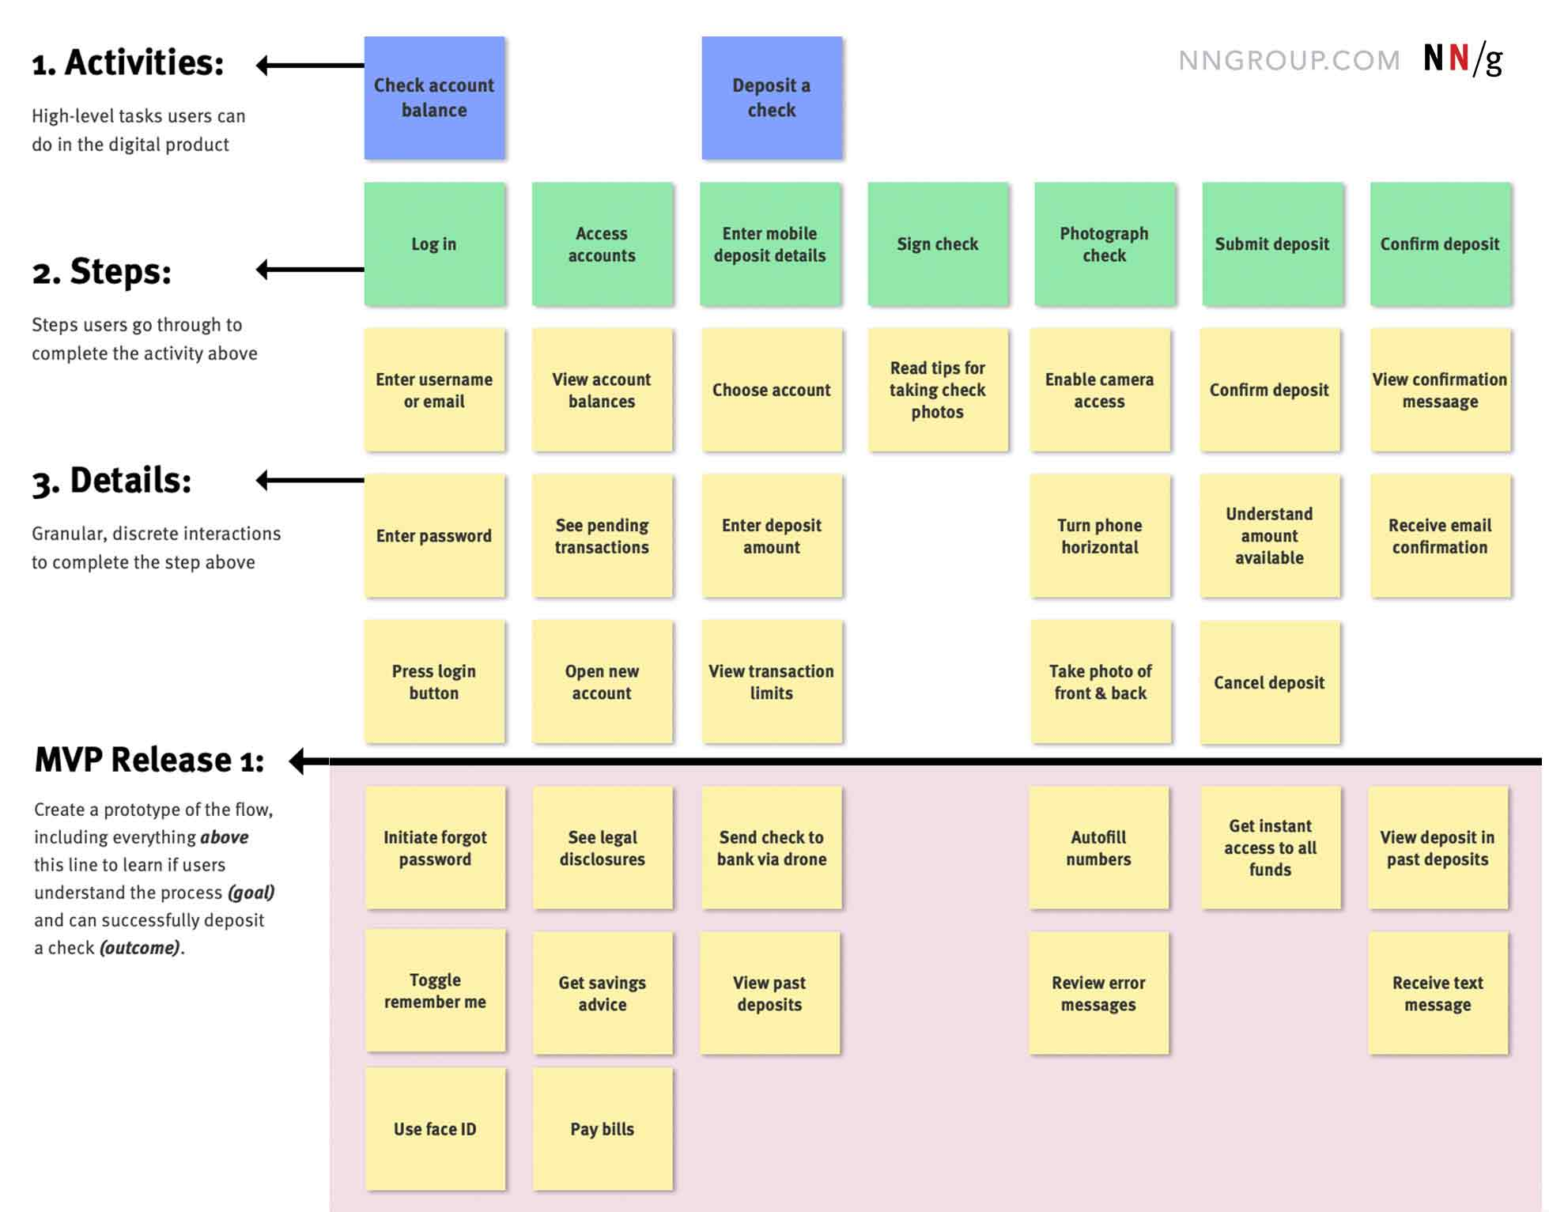
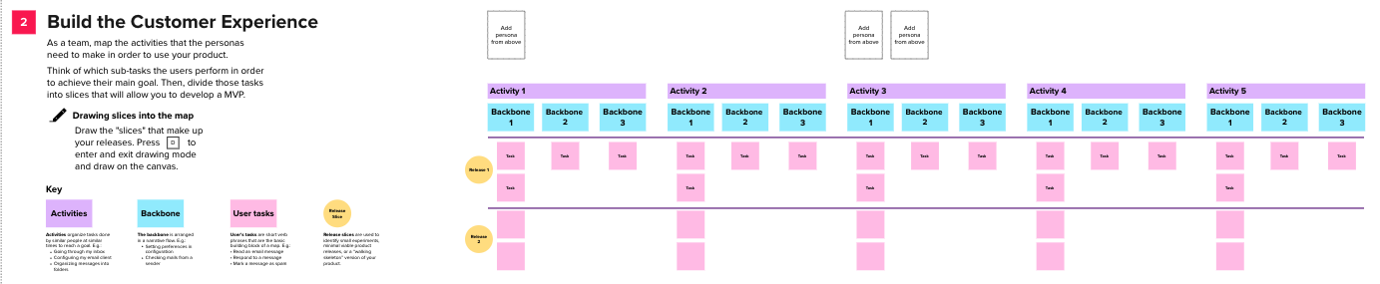
Mapping User Stories
50 minutes
Now, you will do this with your groups for your own project before cementing them in Jira. Your Activities will become your Epics, Your Backbones/Steps will be your User Stories, and your User Tasks will be structured as Acceptance Criteria to break these up into actionable steps for you to work on during development.
Image: https://www.nngroup.com/articles/user-story-mapping/
Notes:
You will have different steps and user tasks in each release based on prioritizing what is vital to the software in addressing the needs of the user AND producing something unique to them (UVP from last week). This means your MVP release 1 should have vital software features to address user needs (and possibly account creation etc.) as well as your unique value proposition. Release 2 will add additional features which are not vital to operation but still add value for your users, or open the functionality up to a broader target audience. Each Release after the MVP will address bugs in the previous release, while adding something useful. In the next 5-6 weeks you should only have 2-3 releases but you may map a 4th as you will be asked to address next steps in your final assessments.

Slide 7
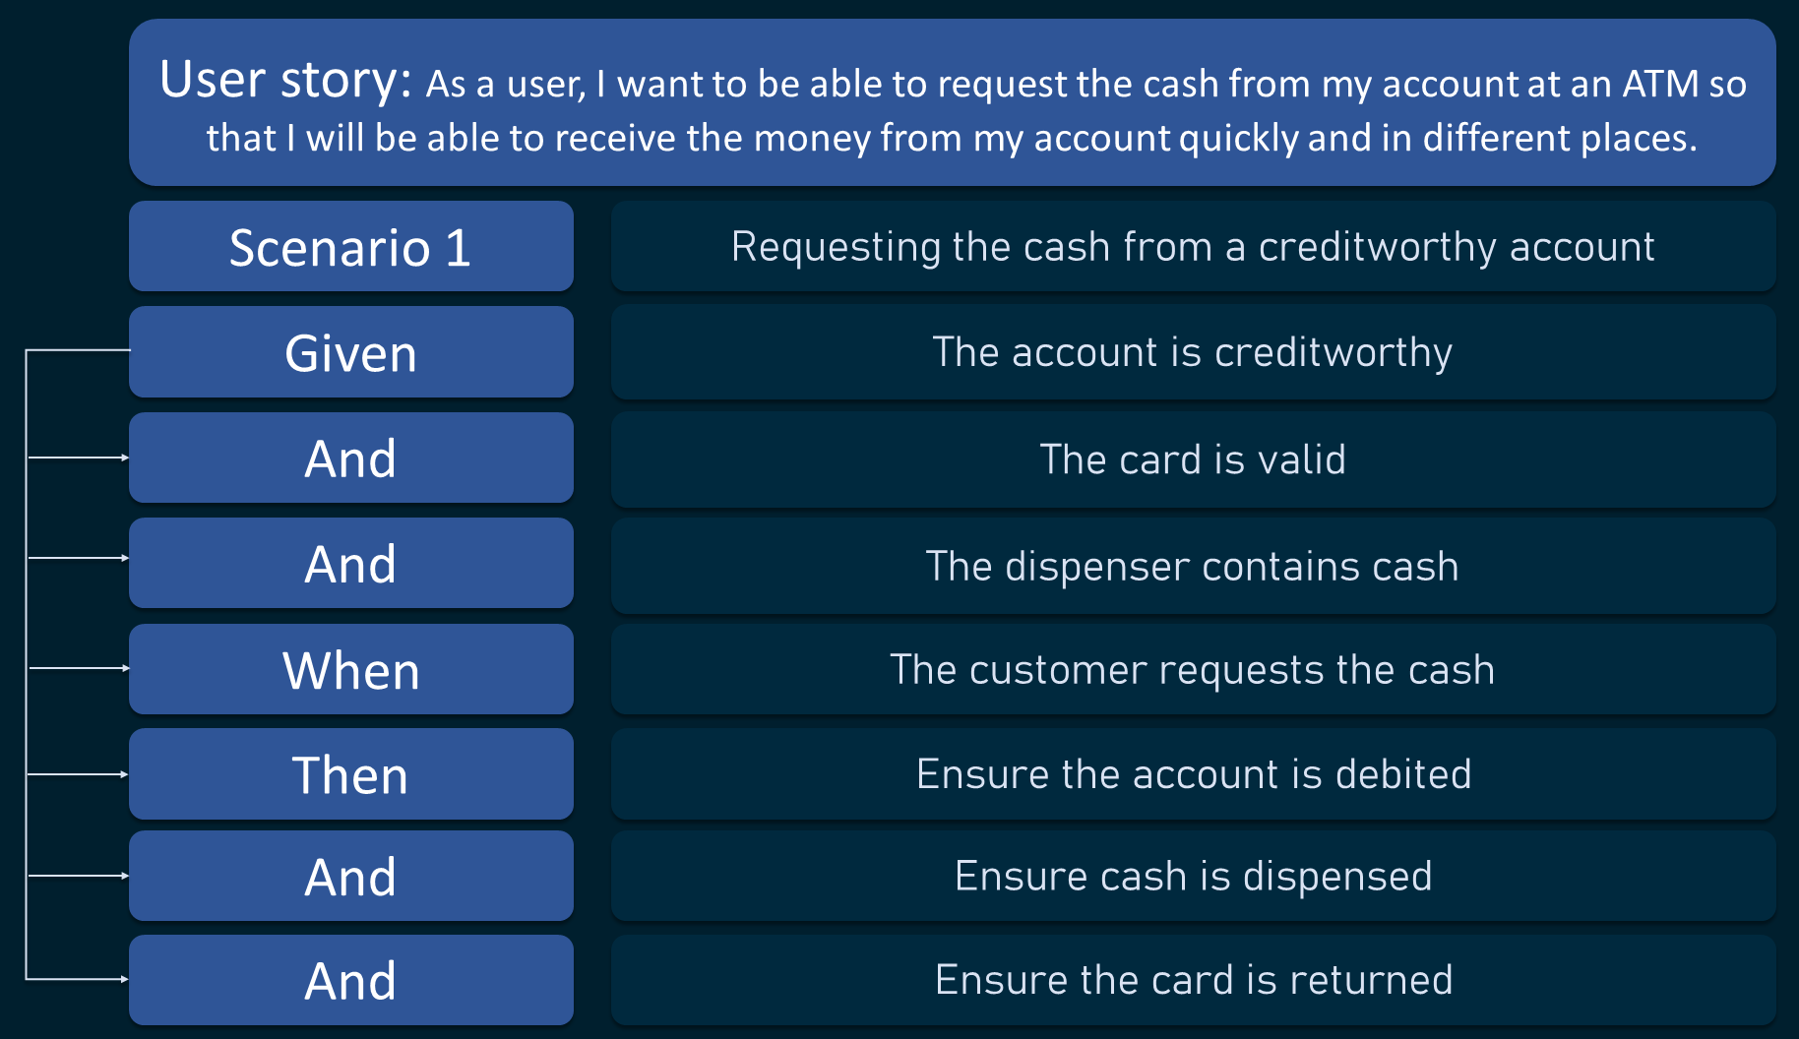
Acceptance Criteria
Structuring User Tasks
Acceptance criteria are mini workflows which highlight each user task that is necessary for achieving a User Story. An ATM example is highlighted below. This is known as the "Given/When/Then template, and you may have as many 'ANDs' in each step as you require so that it is specific and actionable.

Slide 8
Group Work
50 minutes
This is now your group work time where you can work in your group on your project deliverables
What should we be doing?
Using your research summary, you should now be working on getting your user stories out to prepare for mapping out your sprint.
Try and add acceptance criteria to each of the user stories as you go so you can see potential gaps
Your demonstrator will walk around and check in with each group to provide feedback on your progress and answer any questions you may have
Intro | Mapping User Stories | Group Work | Wrap-up
5 min | 50 min | 50 min | 5 min
all | all | group | all
Notes:
As always, leave 5-10mins for wrap up and be helping the groups/checking on progress.

Slide 9
Group Work
50 minutes
Each week we will check in on where we are at with our projects to make sure that everyone is moving towards the same goals.
Week 1
Week 2
Week 3
Week 4
Week 5
Week 6
Week 7
Week 8
Week 9
Week 10
Week 11
Interim Report
Prelim Report
Design Presentation
Final Report
What is my problem?
What about a potential solution?
Test and Iterate
Did you consider accessibility?
Who is my user?
What do my users want?
Envisage the solution
Test and Iterate
Document and present
User Stories
Test and Iterate

Slide 10
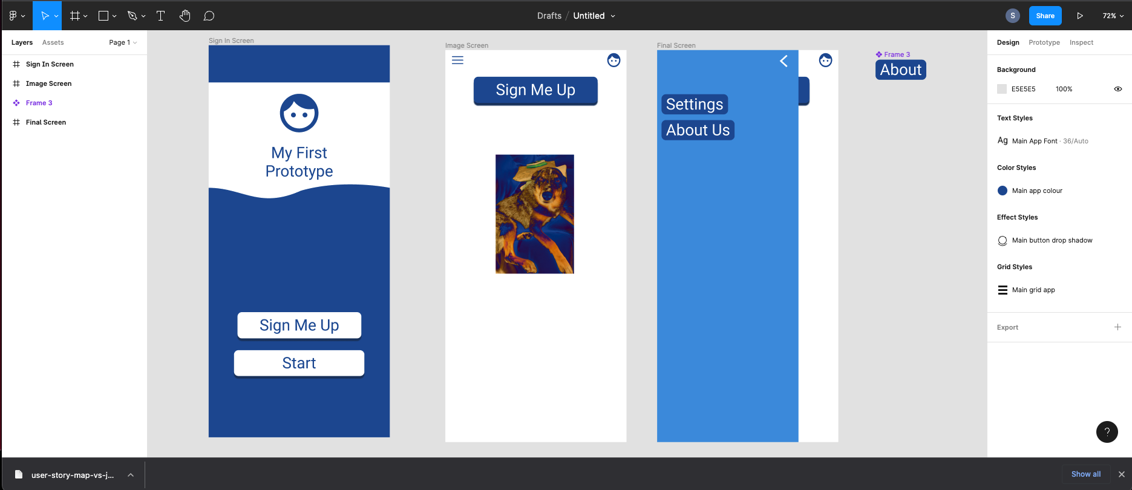
Next week – Prototyping
Prototyping successfully
Let’s use Figma to create a little prototype from some of the user stories you created in your classes last week.

Slide 11
Wrap
5 minutes
Reflection: What do you think are the benefits of doing the user story mapping as a team?
Intro | Mapping User Stories | Group Work | Wrap-up
5 min | 50 min | 50 min | 5 min
all | all | group | all

